Slide 1
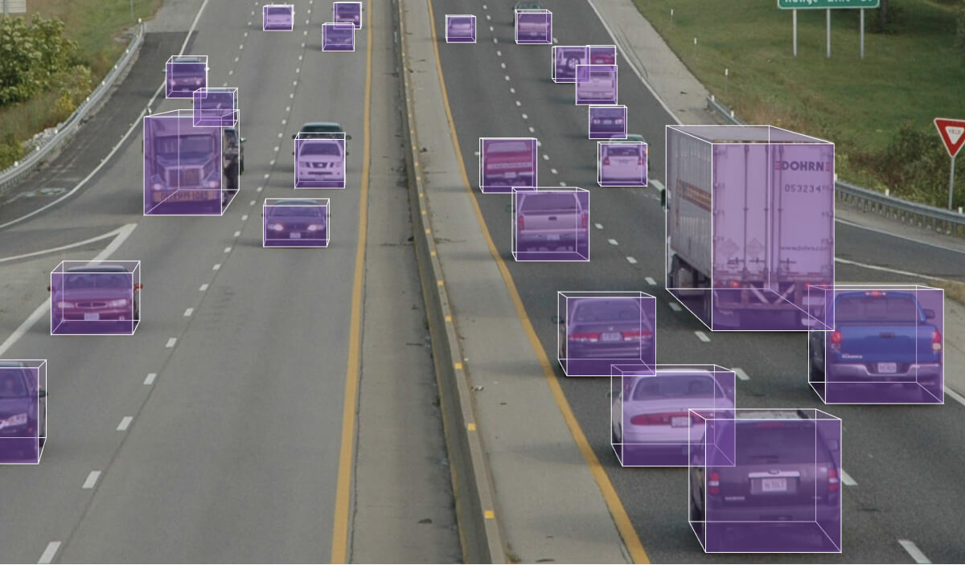

Computer Vision

Slide 2

What is Computer Vision
Field of Artificial Intelligence
Teaches computers to see and understand the world around them
Focused on identifying and classifying different objects and people within images and real-time data

Slide 3
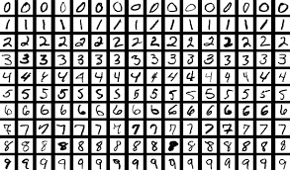
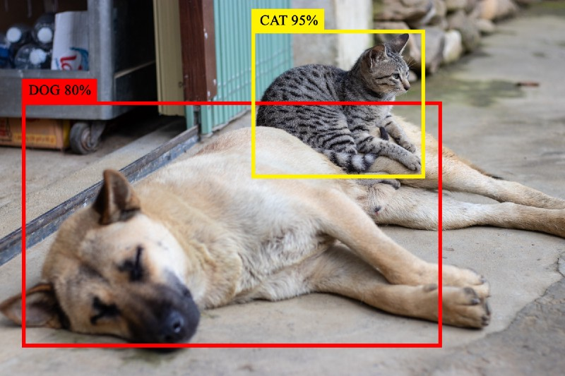
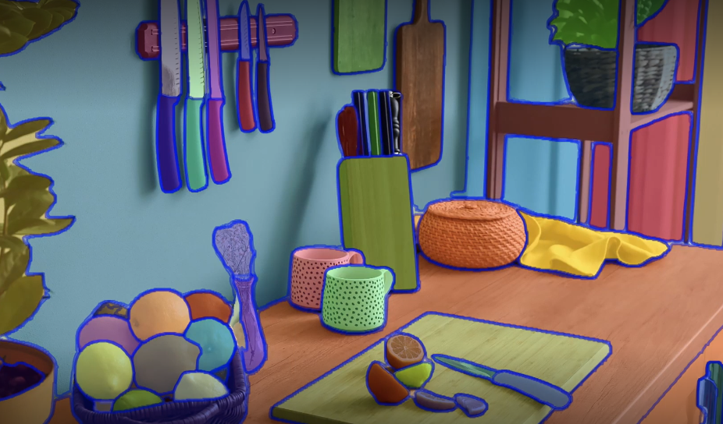

Computer Vision Comes in a Variety of Forms
Classification
Detection
Segmentation
Focused on the categorization of images into distinct groups. Typically, the model outputs a single prediction of the highest-confidence category.
See: Today’s Demo!
Capable of classifying and locating objects within an image, typically via a bounding box. Models are often capable of locating several distinct objects.
See: YOLO V7
Partitions an image into discrete groups of pixels (or segments) to simplify the representation of image data to something more meaningful.
See: Meta SAM

Slide 4

The Building Blocks of CV
Image Processing
Edge Detection
Filtering
Convolution
Convolutional Neural Networks
Feature extraction
Pooling
Data annotation

Slide 5




Traditional Steps
Receiving Image Data
(Via Cameras, Sensors, etc.)
Processing Image and extracting relevant features Goal: prepare the visual data for further analysis
Feature Extraction
Various techniques, including edge detection, blob and texture analysis, etc.
Pattern Recognition
Patterns are learned through analysis of extracted features and predictions are made based on the data

Slide 6
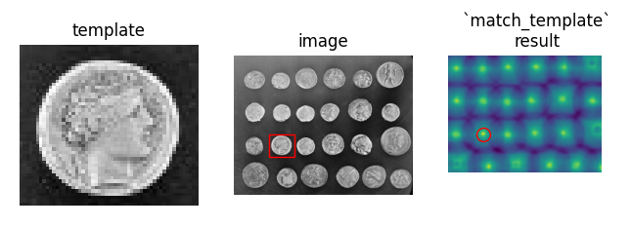
History of CV
1980s
Template Matching
- Marching a template image across a photo to locate instances of object
1990s
Support Vector Machines and Decision Trees
- Statistical Machine learning becomes popular
- Enables early face-recognition and object detection techniques
2000s
Rise of Deep Learning
- A surge in compute power enables deep, dense networks to be viable.
- CNN Architecture becomes common

Slide 7
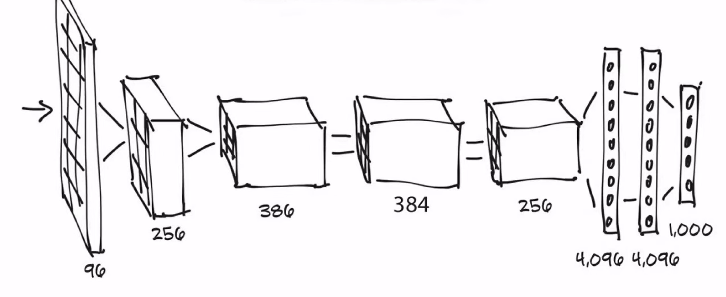
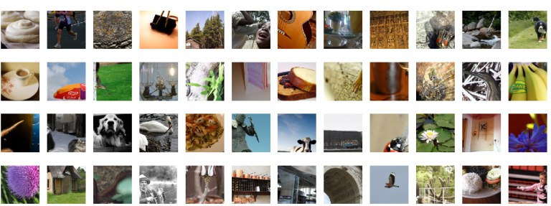
A Breakthrough in the Field
AlexNet achieves 84.7% accuracy on ImageNet dataset in 2012
Demonstrated the proficiency of CNNs in image-recognition tasks
ImageNet
Computer Vision challenge
Hand-Annotated dataset of 14 Million Images
AlexNet Model Architecture
ImageNet Dataset Samples

Slide 8
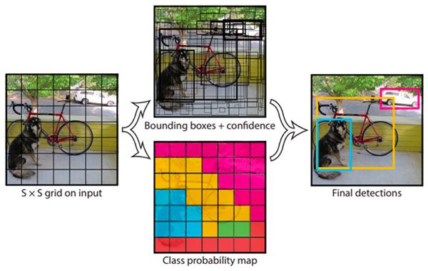
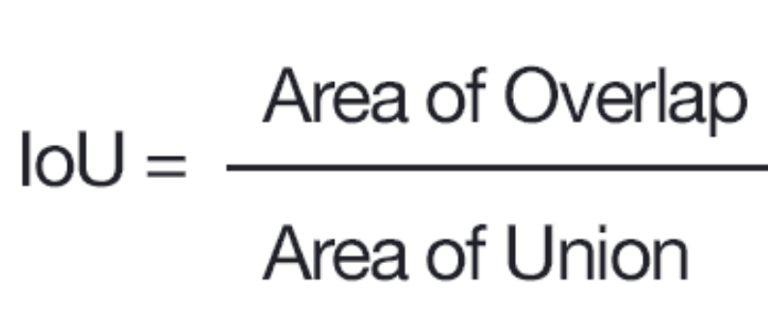
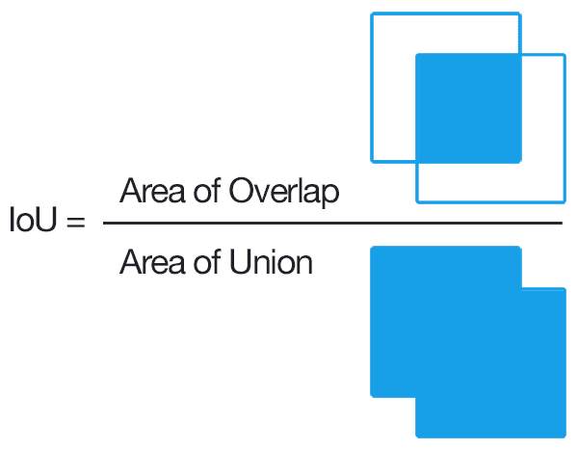
Modern Approaches
YOLO Model (You Only Look Once)
Utilizes a Convolutional Neural Network (CNN)
Trained by analyzing predicted and ground-truth bounding boxes

Slide 9
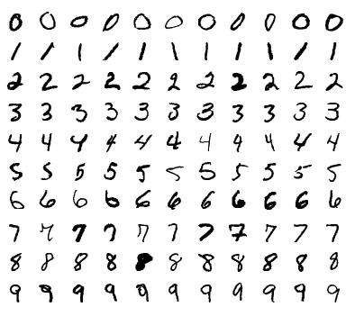
Live Demo: Classification with MNIST Dataset
https://github.com/ConnorUsaty/MacAIEducation2023

Slide 10


Slide 11



Thanks for Listening!

